Slide 1


Slide 2
Student name:udhaya kumari. P Reg NMID: 22922924u18045 Department:B.SC (computer science) College name: sri bharathi womens arts and science college University: thiruvalluvar
Music website

Slide 3


Slide 4
online platforms that serve diverse functions for music lovers and creators, such as streaming music, discovering new artists, buying music or merchandis of music
Music

Slide 5
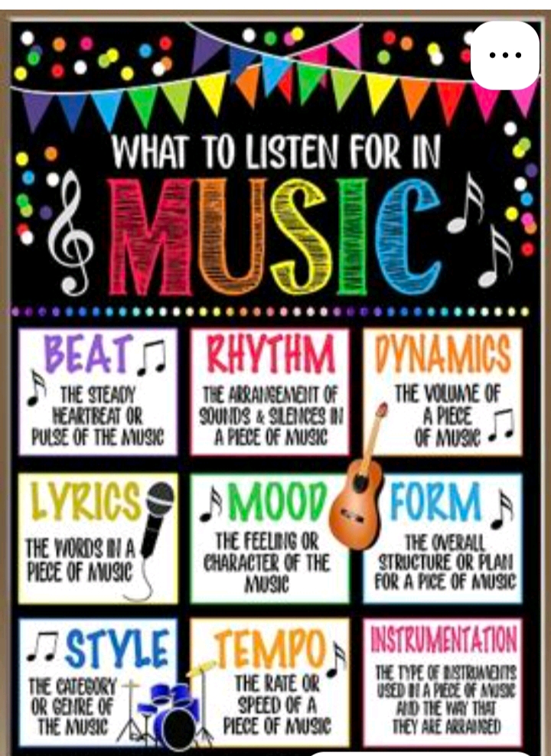

Slide 6
playing music for a while, you probably already have some branding in place — even if that's just your own image. Look for a template with a large header area for a full band photo, a template with a square main image if you have a social media photo, or a template with space music
Artist branding

Slide 7
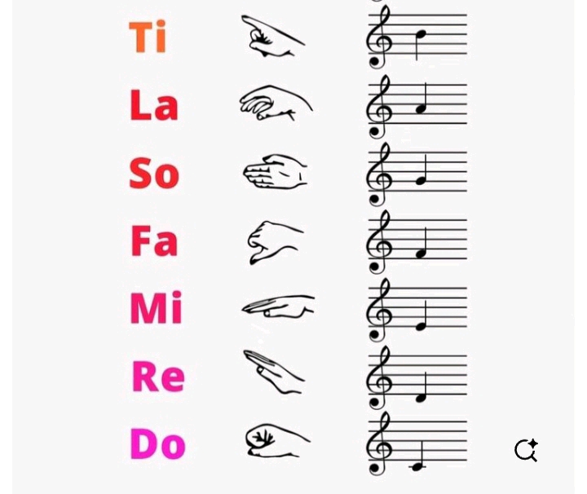

Slide 8
musician’s website is the Music page. Treat it as a main hub for everything there is to know about your music. Add your albums with detailed descriptions as well as the places to stream your music. This is not working properly and the music wave of my knowledge and belief I love music
Music page

Slide 9


Slide 10
<audio controls> <source src="your-music-file.mp3" type="audio/mpeg"> Your browser does not support the audio element. </audio>
Source code

Slide 11
Artist/Band Websites: A professional, customized online presence for an artist or band, acting as a central hub for all their information. Music Streaming Platforms: Websites where users can stream music, such as Spotify or SoundCloud, often with a vast library of curated and music
Music website

Slide 12
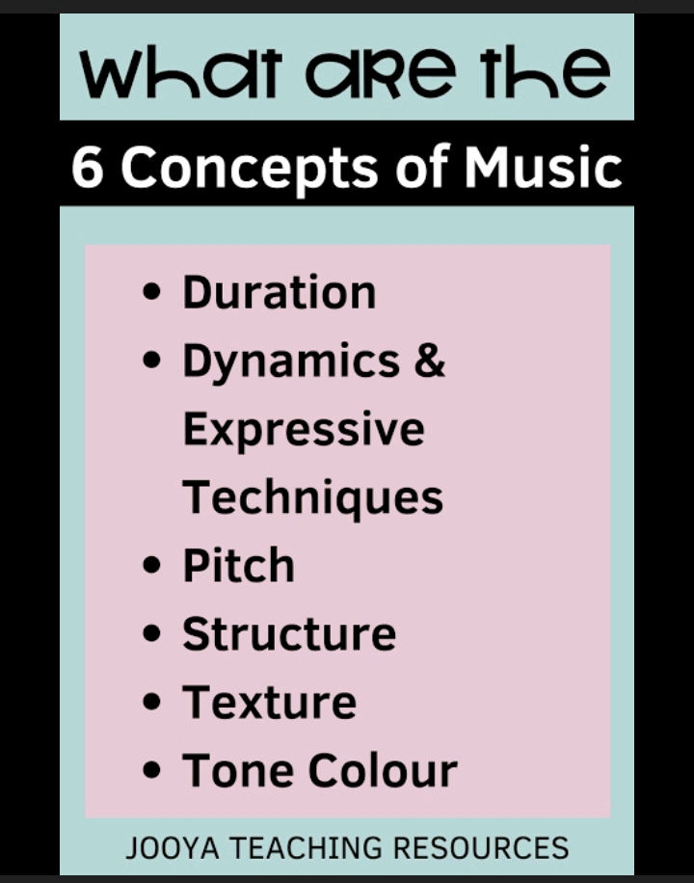

Slide 13
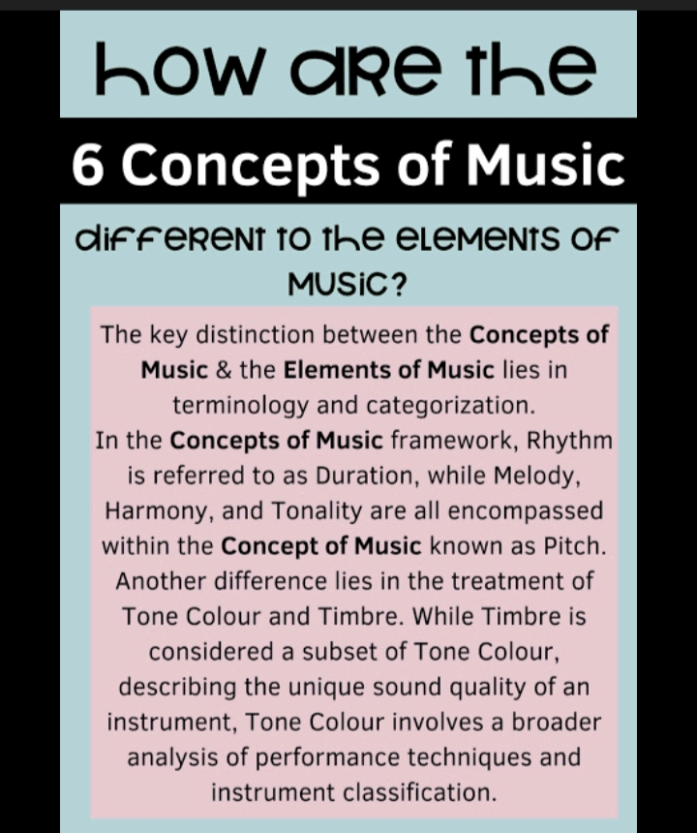

Slide 14
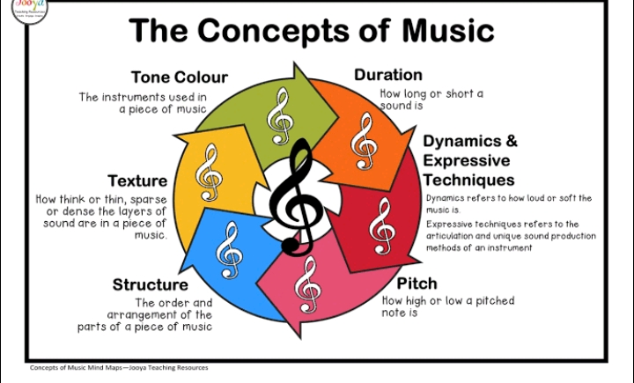

Slide 15


Slide 16


